Slide 1

Comparing Neural Network and GARCH-type Models for Forecasting Volatility: An Analysis of Major Global Stock Indices
Afet Ibadova

Slide 2
Agenda
Introduction
Research Question and Hypotheses
Methodology
Pre-modelling
Modelling – GARCH-type
Next steps

Slide 3
Introduction
Purpose: To evaluate the predictive capabilities of LSTM neural networks against traditional GARCH-type models in forecasting stock volatility.
Importance of Volatility: Critical for risk management, investment strategy, and financial decision-making.
Model Overview: Comparison of traditional GARCH-type models with advanced LSTM neural networks.
Relevance: Addressing the need for improved volatility forecasting tools in increasingly unpredictable financial markets.
Presentation Objective: Demonstrate findings from empirical comparisons using historical data from major global indices.

Slide 4


Research Question and Hypotheses
Research Question: How do LSTM neural network models compare to traditional GARCH-type models in forecasting the volatility of an equally weighted portfolio comprising major global indices?
H0: No significant difference in forecasting accuracy between LSTM models and GARCH-type models.
H1: Significant difference in forecasting accuracy between LSTM models and GARCH-type models.
H0: LSTM models do not offer significant improvement in handling non-linear dependencies.
H1: LSTM models significantly improve the handling of non-linear dependencies.
Notes:
Hypothesis 1 (H1):
Focus: The first hypothesis is concerned with the forecasting accuracy of the two models. It compares the predictive performance of LSTM models directly with GARCH models.
Nature of Comparison: This is a direct comparison of end outcomes, which is the accuracy of the forecasts made by each model.
Implication: The result of testing this hypothesis will tell you which model is more accurate in forecasting volatility, without delving into the reasons or mechanics behind their performance.
Hypothesis 2 (H2):
Focus: The second hypothesis addresses the capability of LSTM models in capturing non-linear dependencies within the data, which is a more nuanced approach to understanding model performance.
Nature of Comparison: This is not just a comparison of outcomes but of the models' underlying capabilities to handle complex data patterns.
Implication: The testing of this hypothesis will shed light on whether the advanced architecture of LSTM models provides a substantial advantage in processing and utilizing non-linear information from financial data, which may not be fully utilized by GARCH models.
Key Differences:
Aspect of Model Performance: H1 focuses on the output (forecasting accuracy), whereas H2 is concerned with the process (ability to handle non-linear dependencies).
Type of Data Analysis: H1 might rely on traditional accuracy measures (like mean squared error), while H2 might involve a deeper analysis of the models’ structure and function, such as their ability to process time-series data with non-linear characteristics.
Implications for Financial Modeling: H1 aims to identify the more accurate model for practical application, while H2 seeks to understand the inherent strengths of LSTM models which could influence their broader applicability in finance and econometrics.

Slide 5
Methodology
Stocks | SP500, DAX, WIG20, KOSPI200, NIKKEI225 (equally weighted portfolio)
In-sample | 2000/01/06 – 2019/03/22
Out-of-sample | 2019/03/25 - 2024/01/25
Current Models | ARCH(1), GARCH(1,1), GARCH-t, EGARCH, TGARCH
Next Models | ARIMA-GARCH, LSTM

Slide 6
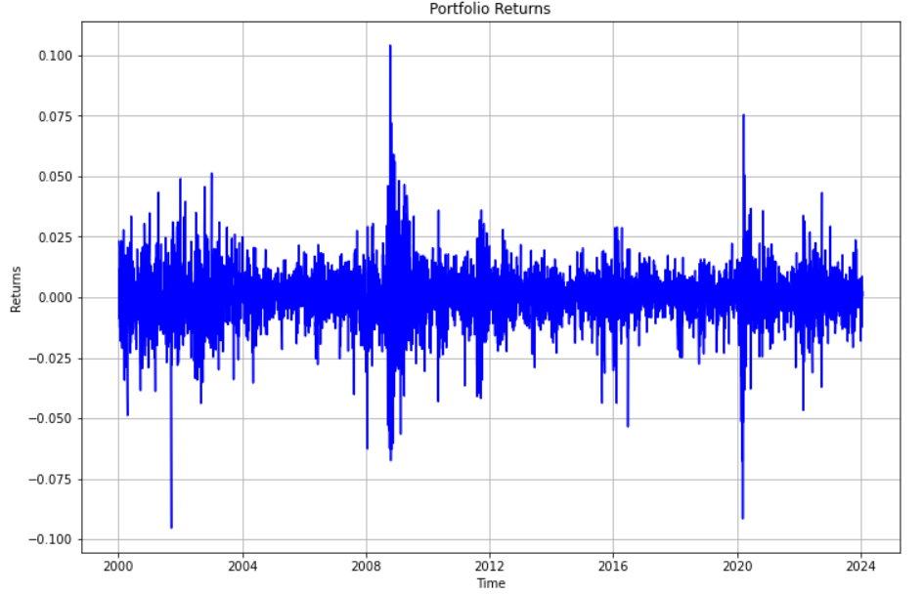
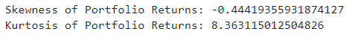
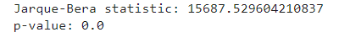
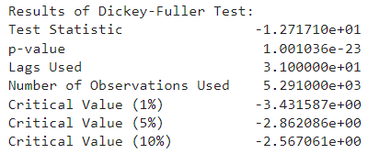
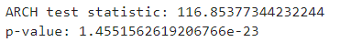
Pre-modelling
Notes:
Skewness of Portfolio Returns: The skewness value is approximately -0.444, indicating a slight left skew, meaning there's a longer tail on the left side of the distribution. In financial data, this could imply a higher frequency of negative returns than positive ones.
Kurtosis of Portfolio Returns: The kurtosis value is approximately 8.36, significantly higher than 3, which is the kurtosis of a normal distribution. This suggests that the returns have heavy tails and a sharp peak, indicating a higher probability of extreme returns compared to a normal distribution.
Jarque-Bera Test: The test statistic is extremely high, and the p-value is 0.0, which practically means the distribution of returns is not normal. The test evaluates skewness and kurtosis jointly against the normal distribution. The results strongly reject the null hypothesis of normality.
Dickey-Fuller Test: This test checks for stationarity in time series data.
The test statistic is -1.2717e+01, which is more negative than any of the critical values provided for the 1%, 5%, and 10% levels.
The p-value is extremely low (about 1.00e-23), suggesting the rejection of the null hypothesis of a unit root (non-stationarity). Thus, the series is considered stationary.
ARCH Test: The ARCH test evaluates autoregressive conditional heteroskedasticity.
The test statistic is 116.85, and the p-value is extremely small (around 1.46e-23). These results indicate significant ARCH effects, meaning that there are clusters of volatility in the time series data.

Slide 7
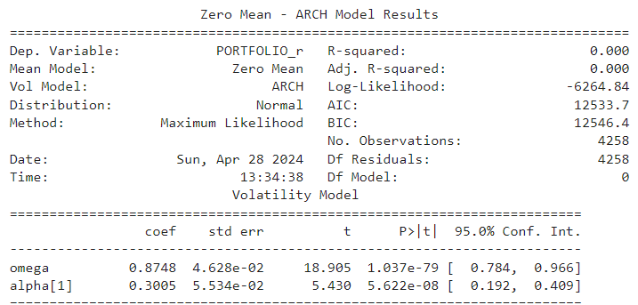
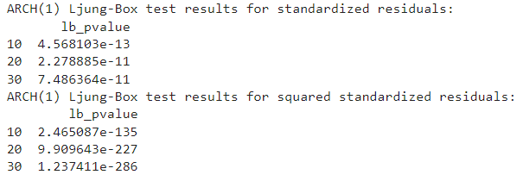
ARCH(1)
The Ljung-Box test results for the standardized residuals indicate significant p-values at all tested lags (10, 20, 30), pointing to serial correlation in the residuals.
The Ljung-Box test results for the squared standardized residuals show extremely low p-values at all tested lags, suggesting strong serial correlation in the variance of the series.
Given the significant results from the Ljung-Box tests on both residuals and squared residuals, there is evidence of model inadequacy in capturing all the dynamics in the data, pointing towards potential volatility clustering that the ARCH(1) model fails to fully explain.

Slide 8
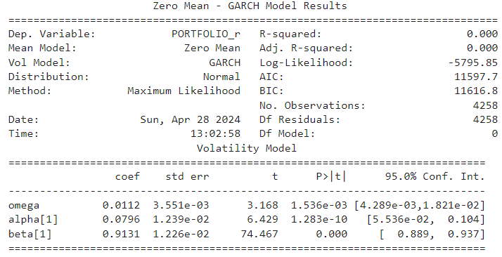
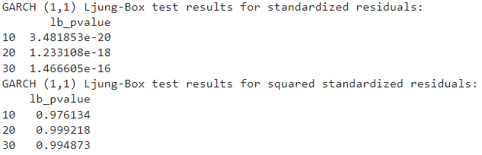
GARCH(1,1)
The significant values of both alpha and beta coefficients indicate that not only does the immediate past volatility affect the current volatility (alpha effect), but also that past volatility has a long-lasting effect (beta effect). This model effectively captures the 'volatility clustering' effect.
The persistence of volatility, as suggested by the sum of alpha and beta close to 1 (approximately 0.993), indicates that shocks to volatility are highly persistent, decaying very slowly over time.
Extremely low p-values at lags 10, 20, and 30 suggest significant autocorrelation in the standardized residuals. Since this test assesses linear relationships, the implication is that there may be some linear structure in the residuals not captured by the GARCH(1,1) model.
The p-values are very high, close to 1, for the squared standardized residuals at all specified lags. This indicates that there is no significant autocorrelation in the squared residuals, which implies the GARCH(1,1) model is successful in capturing volatility clustering.
The Jarque-Bera test statistic is significantly high, and the p-value is essentially zero, rejecting the null hypothesis of normal distribution of residuals.

Slide 9
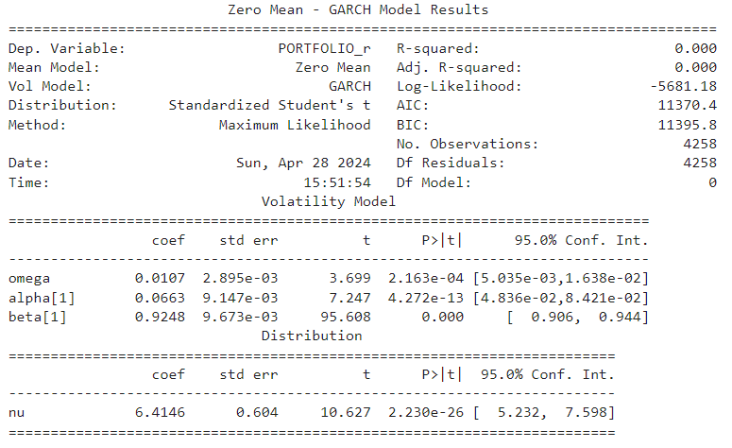
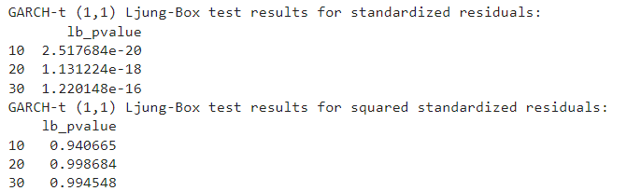
GARCH-t (1,1)
With the coefficients alpha and beta summing to close to 1, the model implies that volatility shocks will be highly persistent, a feature that is very useful in risk management and derivative pricing which rely on accurate volatility forecasts.
The significant autocorrelation in the standardized residuals suggests that the model might not be fully explaining all the temporal dependencies in the data, which could be due to leverage effects or other complexities not captured by a GARCH-t(1,1) model.
Despite the significant autocorrelation detected in the residuals, the lack of it in the squared residuals is reassuring for the volatility modeling aspect. It would be beneficial to explore more sophisticated GARCH variants that can model asymmetric effects or different risk metrics that could be more sensitive to the patterns present in the standardized residuals.

Slide 10
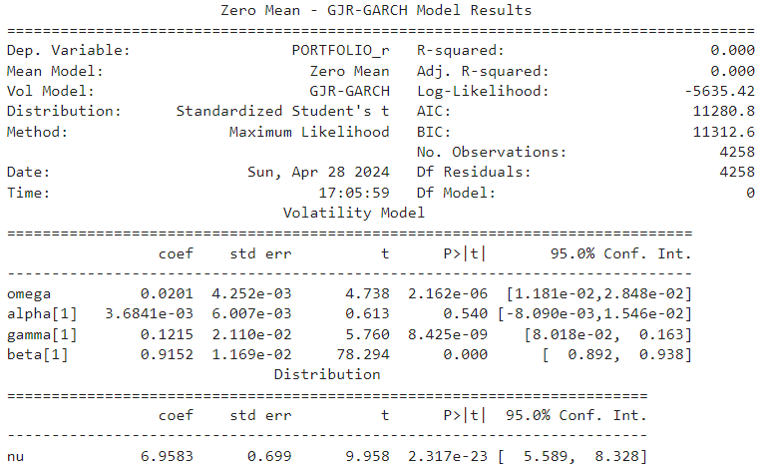
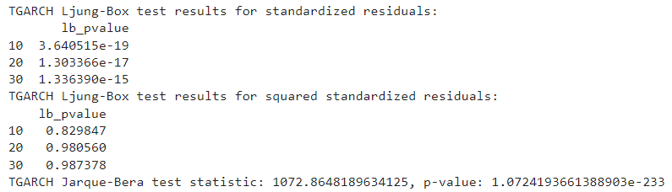
GJR-GARCH
The TGARCH model appears to handle the volatility clustering well, as indicated by the lack of autocorrelation in the squared residuals. However, the significant autocorrelation in the standardized residuals suggests that the model may not be fully describing the linear aspects of the return series. This could potentially be investigated further by examining if there are omitted variables, structural breaks, or other non-linear dynamics at play.
Despite the significant autocorrelation detected in the standardized residuals, the model seems effective for volatility forecasting due to its proper accounting for volatility clustering. The high p-values in the Ljung-Box test for squared residuals are indicative of an adequate volatility model.
Given the test results, there could be a case for exploring other models or including additional terms in the TGARCH model to better capture the linear dependencies indicated by the standardized residuals.

Slide 11
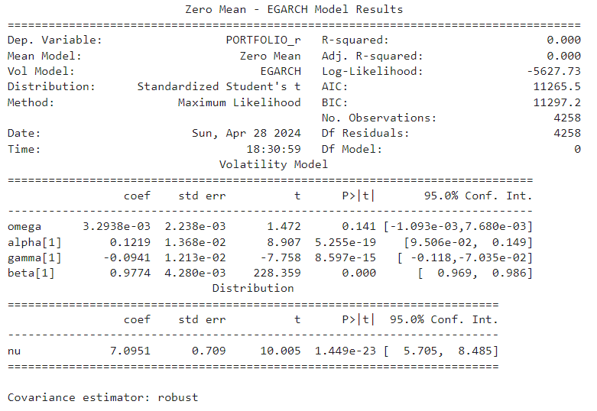
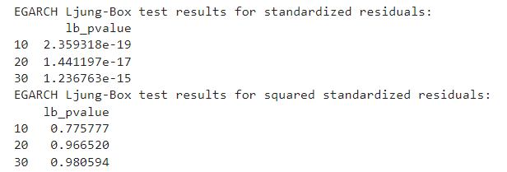
EGARCH
The EGARCH model has identified significant volatility dynamics within the 'PORTFOLIO_r' series, capturing both the size and sign of past shocks.
The high persistence in volatility as indicated by the beta value suggests that any volatility forecasting will need to account for this long memory effect.
The negative gamma coefficient aligns with the often-observed phenomenon in financial markets where bad news increases volatility more than good news of the same magnitude (leverage effect).
The very small p-values for the LB test at different lags (10, 20, and 30) suggest that there is significant autocorrelation in the standardized residuals of the EGARCH model. Ideally, for a well-fitting model, the standardized residuals would show no autocorrelation.
The p-values for the squared standardized residuals are relatively high, especially for lags 20 and 30, indicating that there is no significant autocorrelation in the squared residuals. This suggests that the EGARCH model has been successful in modeling the volatility clustering in the data, as squared residuals would represent volatility.

Slide 12
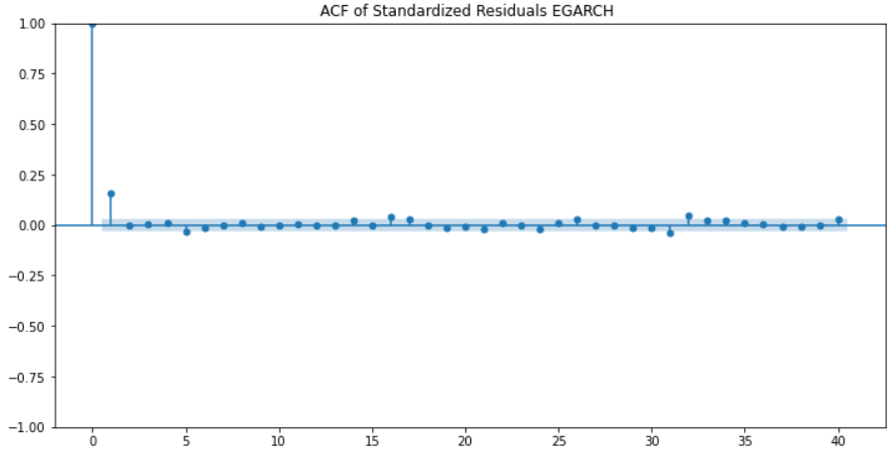
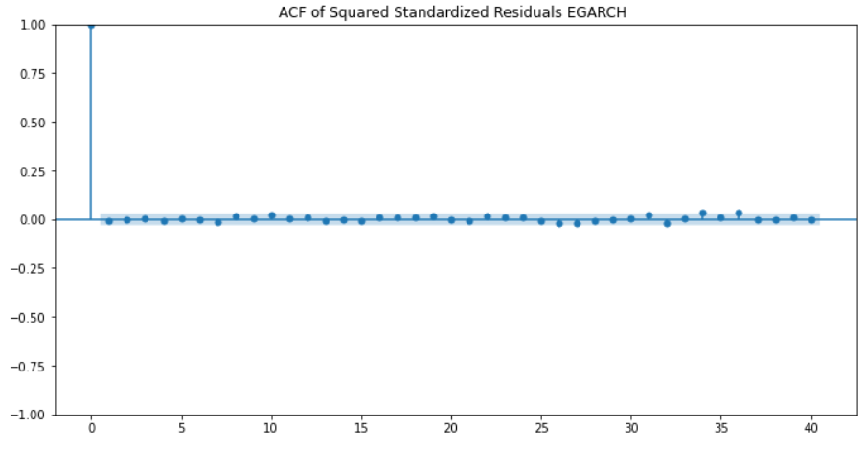

Slide 13
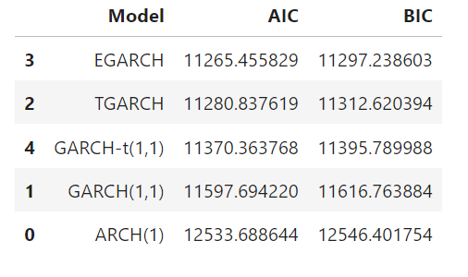
Comparison
*Comparison of current models

Slide 14
What is next?

Slide 15
Thanks for your attention!
Questions?

